Slide 1



Welcome to the Pre-Bid Conference for Shopping Procurement
For “Graphic Design Services for MCA-Kosovo” Ref. No. 24-3016
Purpose: To provide guidance and tips for a successful offer submission
June 24, 2024

Slide 2
Procurement Opportunities Advertisements
How can you learn about procurement opportunities?
General Procurement Notice
Specific Procurement Notice
General Procurement Notice, which shall include procurements planned for upcoming period:
every quarter and
upon updates to the approved Procurement Plan
After the GPN, specific procurement announcements and details for offer submission are advertised.
Used to announce prequalification or short-listing procedures and inform about the availability of bidding or proposal documents.
Same web-sites as the GPN.

Slide 3
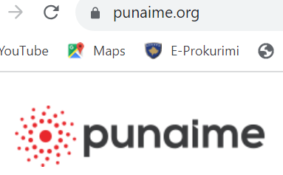
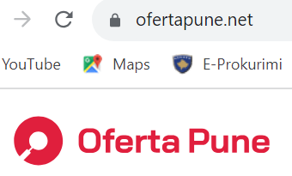
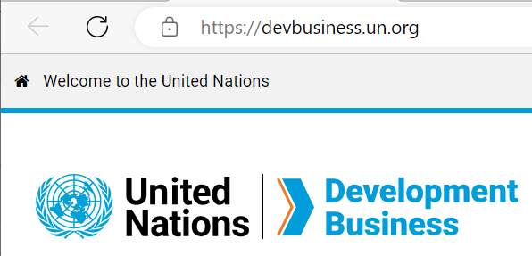
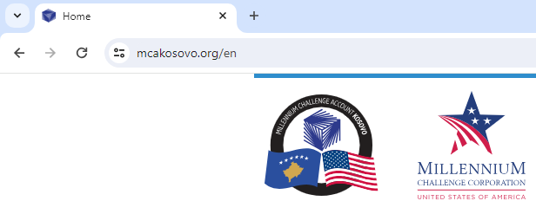
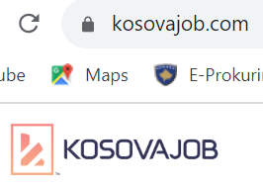

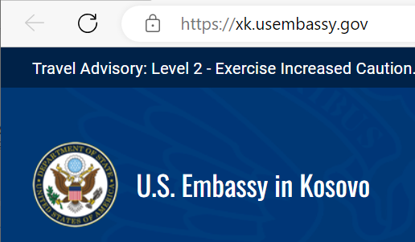
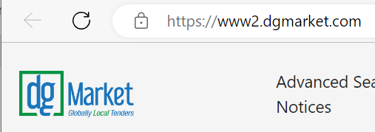
MCA entity will publish the GPN & SPN:

Slide 4

Offers’ Database
MCA has a common database for various offerors and consultants.
Following the publication of the GPN and SPN, any offeror may contact us at to provide information about their organization and share their e-mail addresses.
This enables us to include them in our records for potential future procurement activities.
mcakosovopa@dt-global.com to contact you when bids are published!

Slide 5
Procurement Procedure Overview
Shopping
Review of offers & Contract
Price quotations from at least three offerors
Goods, non-consulting services or simple civil works
RFQ can be sent via e-mail or published on a local website
Offers are submitted electronically via pCloud (no public opening required)
Approved Review committee (3 members)
Contract typically awarded to the substantially and lowest compliant offer
Price reasonableness analysis
No negotiation, only clarifications before award
Compliance with procedures

Slide 6
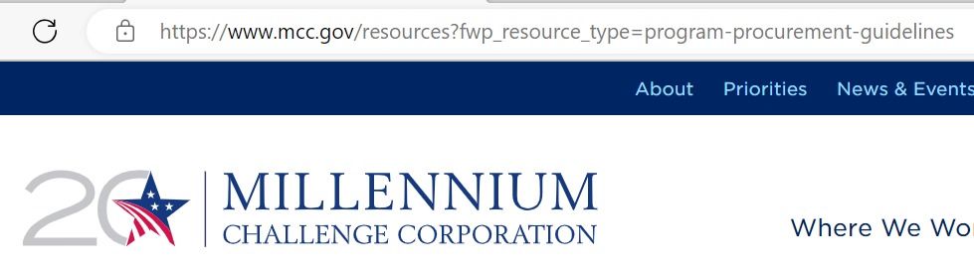

Evaluation Procedures
Evaluation of quotations in accordance with MCC procedures
https://www.mcc.gov/resources/doc/010124-ae-program-procurement-policy-guidelines/

Slide 7
Local Offerors can apply
Shopping Procurement
Pre-bid conference
MCA primarily engages with local offerors for contracting small value services or provision of goods or works.
Local offerors can respond to requests faster.
Offerors will be invited to attend to the pre-bid conferences.
MCA-Kosovo provides instructions how to present the Offers.
Respond to any questions of offerors.

Slide 8
Frequently Requested Items & Most Common Mistakes
Scope of the Services and requirements
List of Prices and Form of Quotation
Declaration of Compliance
Timely Submission
Signed and stamp by the authorized representative
Power of Attorney of the person signing the Offer.
The Offeror must have at least 3 years of experience in providing design services for print, online, and press. The required experience period will be calculated from the date of legal registration of the Offeror's business.
- Minimum 3 proofs of recent experience within last three (3) years in designing for print and press – to provide letters of recommendation or copies of contracts with contact information (email and/or phone numbers) for confirmation of satisfactory contract completion.
The proposed lead designer should have at least 5 years of proven experience in design for print and press. This will be evaluated on a “pass or fail” evaluation methodology. – The CV of proposed lead designer (individual) should demonstrate the required experience in design for print and press.

Slide 9

Frequently Requested Items & Most Common Mistakes
Frequently Requested Items | Most Common Mistakes
Business Registration Certificate | Sometimes the offerors fail to include the Business Registration Certificate which is required.
References (The majority of RFQs do not require references to be provided) | Sometimes offerors fail to include the references requested and this delays the processes, or it may cause disqualification if not provided after a request for clarification. Incomplete information, no contact details.
Timely Submission | Some offerors do not pay sufficient attention to deadlines. The dedicated link for submissions will expire after the set date.
Signed and stamp by the authorized representative | Sometimes offerors fail to sign and stamp the offer submission form by the authorized representative. This is a reason for disqualification.
Person signing the offer is not the authorized representative. | Sometimes the person signing the Offer is not the same authorized in Business Registration Certificate. If this is the case, the offeror must include in its offer a signed Power of Attorney providing authorization to sign the offer on behalf of the Offeror.

Slide 10
Frequently Requested Items & Most Common Mistakes
Frequently Requested Items as Applicable | Most Common Mistakes
Proof of authorization or Power of Attorney not included. | Sometimes, offerors fail to include the proof of authorization or power of attorney given to the signatory of the offer, which is essential in in legal, business, and administrative contexts.
List of relevant previous experience indicating: name of the organization year of performance | Omitting to provide the name of organization/offeror and year of performance
Bid amount (mistakes, calculation errors) | Sometimes, the offerors fail to provide all the items’ prices, or offers present miscalculations. No providing the prices of all the items is a reason for rejection of the offer.

Slide 11
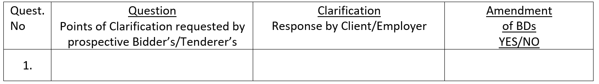
Request for clarifications
Requests for clarifications shall be submitted to MCA in written only.
Request for clarifications shall be submitted not later than June 25, 2024.
Requests for Clarifications shall be sent to the following email: mcakosovopa@dt-global.com, indicating the number and the name of the procurement.

Slide 12
Clarifications
MCA-Kosovo will consolidate all questions received and will issue a Clarification document which is sent to all the bidders.
Clarification on RFQ will be not later than June 27, 2024.

Slide 13
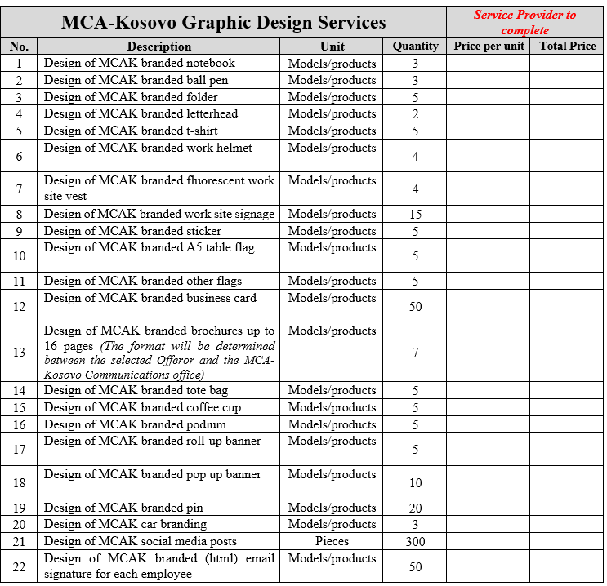
Attachment 2 - List of Prices and Form of Quotation (1) This Form must be completed and signed by the Offeror.

Slide 14
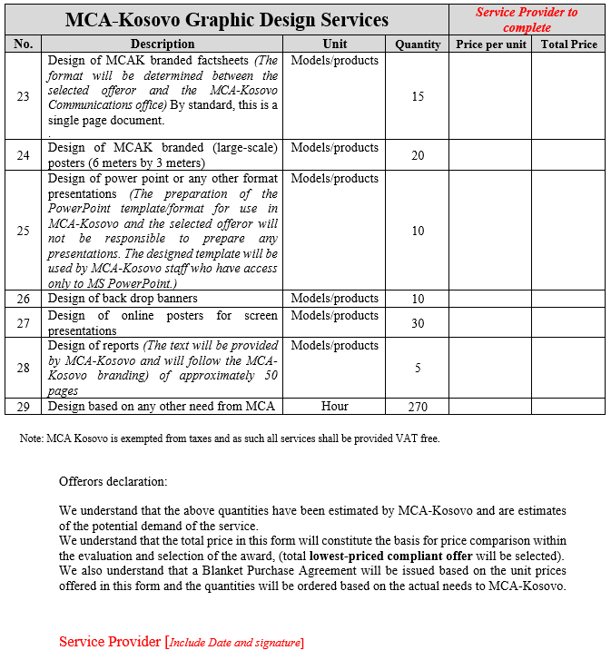
Attachment 2 - List of Prices and Form of Quotation (2) This Form must be completed and signed by the Offeror.

Slide 15
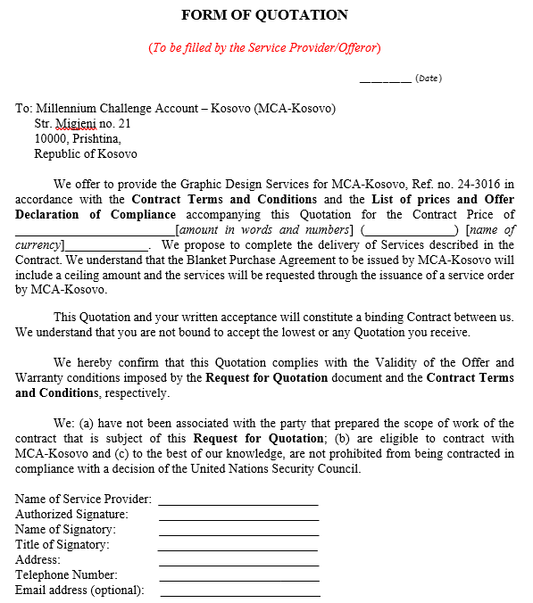
Attachment 2 - List of Prices and Form of Quotation (3) This Form must be completed and signed by the Offeror.
Annex 2: Quotation Submission Form – Schedule of Requirements This Form must be completed and signed by the Bidders.

Slide 16
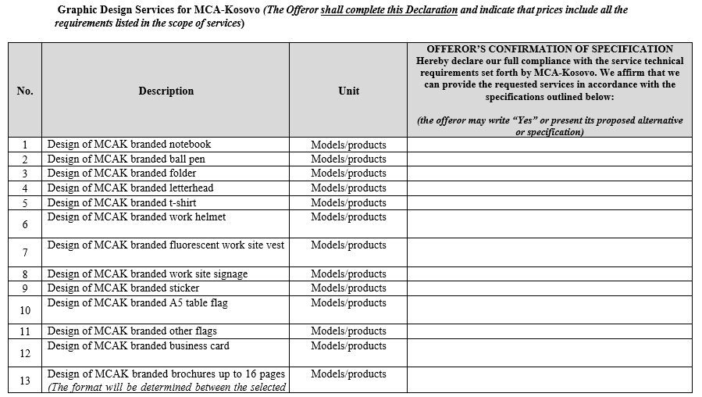
Attachment 3: Offeror Declaration of compliance with the service technical requirements (1)

Slide 17
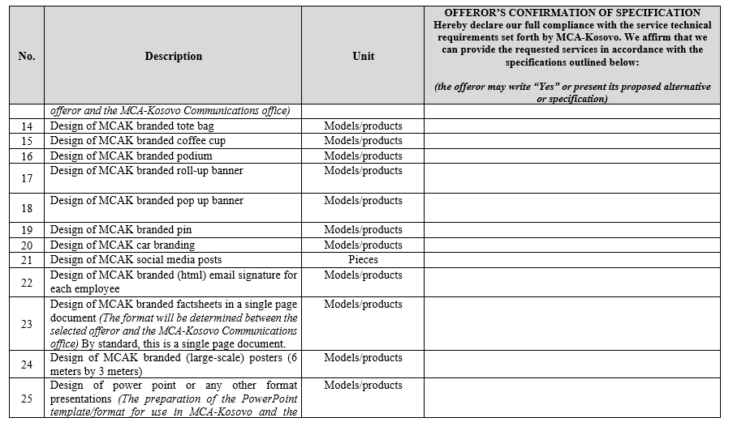
Attachment 3: Offeror Declaration of compliance with the service technical requirements (2)

Slide 18
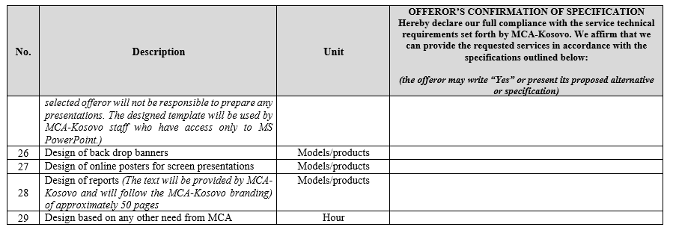
Attachment 4: Sample of a Power of Attorney

Slide 19
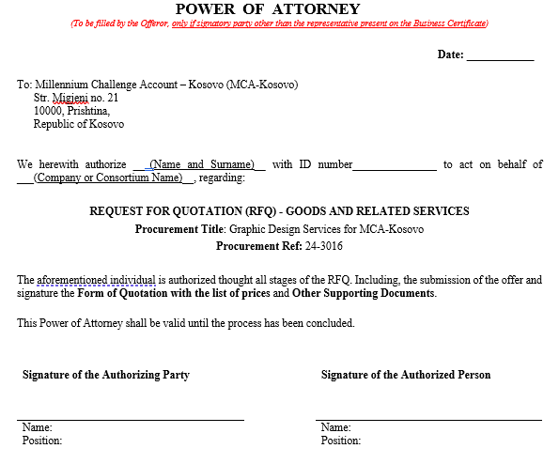
Attachment 4: Sample of a Power of Attorney

Slide 20
Completing Offer Forms (3)
Business Registration certificate
References
Submitted quotation must be typed correct
Signed and stamp by the authorized representative.
Offerors shall submit with their quotation’s copies of the following documents:
a. The most recent business registration certificate in Kosovo.
b. A Company profile with a brief description of the organization, institutional capacity, and an outline of recent experience in providing design services for print and press. The profile should include a slide deck of graphic design work/portfolio.
c. Minimum 3 proofs of recent experience within last three (3) years in designing for print and press – to provide letters of recommendation or copies of contracts with contact information (email and/or phone numbers) for confirmation of satisfactory contract completion.
d. CV of proposed lead designer (individual) which should demonstrate at least 5 years’ proven experience in design for print and press.

Slide 21


Zipped Files
Instruction for uploading your submission
Technical Advice
Type this link correctly in a browser: https://e.pcloud.com/#page=puplink&code=9c77Z5zYtUHey5xzcrW8fyhDUz8uuAnn7
Click Here to Add Files (select your quotation and all relevant documents and click upload)
Enter your: Offerors Name and Email address.
Upload
Late submissions will be automatically rejected as the link will expire on the set date and time.
Link expires after deadline

Slide 22



Tips for a Successful Offer
Thorough Document Review: Carefully review offer documents for a clear understanding.
Complete & Organized Submission: Ensure your offer is complete, well-organized, and follows formatting guidelines.
Early Submission: Submit your offer well ahead of the deadline for ample time.
These steps help you submit a competitive and compliant.

Slide 23
Bid Challenge
Offerors may challenge the results of a procurement
According to the rules established in the Bid Challenge System developed by MCA-Kosovo and approved by MCC: https://mcakosovo.org/storage/app/uploads/public/660/53d/35d/66053d35df65f803631911.pdf
All Offerors should be informed of the decision and given 2 business days to submit a request for debriefing.

Slide 24


Important Remarks
Conflict of Interest
Offers and individuals must avoid conflicts of interest that could hinder their ability to act in the best interests of the MCA Entity. Cannot be hired for assignments conflicting with their obligations to other clients or corporate interests. Will be disqualified from providing consulting services related to goods, works, or non-consulting services they supply for a project. If they have relationships with MCA Entity staff or key project stakeholders involved in procurement processes, they may not be awarded contracts unless conflicts are resolved to MCC's satisfaction throughout the procurement process.

Slide 25
Important Remarks
Conflict of Interest
All participants in the evaluation process, including panel members, auxiliary staff, the MCA, and PA, must act with honesty, prioritize the public interest, and avoid conflicts of interest. If anyone has a conflict, they must immediately inform the Panel Coordinator and refrain from further involvement. Panel members must adhere to MCC's anti-fraud and corruption principles and guidelines as directed by the PA.
To assess conflicts of interest, the definition of "bidder" includes the main bidding entity (such as a joint venture, association, or consortium) and any designated sub-consultant or sub-contractor.

Slide 26
Important Remarks
MCC anti-corruption policy Hotline
All MCC and Accountable Entity staff, and all others working with MCC funding, are required to promptly report suspected incidents of fraudulent or corrupt practices through one of the following methods: Email to hotline@mcc.gov or mcchotline@usaid.gov; Filling out web form on the website of the Office of the Inspector General responsible for MCC (https://oig.usaid.gov/complainant-select); Telephoning the OIG at 1-800-230-6539 or 202-712-1023; Contacting a member of MCC’s AFC Team.

Slide 27

Contract Information
The MCA entity may use:
a service order (SO) or
a formal contract (BPA – Blanket Purchase Agreement)
depending on the procured services.

Slide 28
What is Blanket Purchase Agreement (BPA)
A Blanket Purchase Agreement (BPA) is a binding, long-term procurement contract used in government and corporate settings. It streamlines the purchase of common goods and services, benefiting both buyers and suppliers.
Key aspects and benefits include its formality, long-term nature, simplified procurement process, flexibility, potential cost savings through volume commitments, competitive procurement methods, multi-supplier options for redundancy, legal adherence to terms, potential for modification or termination within agreed conditions, and regulatory oversight and reporting responsibilities for buyers.

Slide 29

Deadline & Clarifications
Reminder, it is essential that all offers are received by July 02 at 15:00 Kosovo time to ensure fair and equitable consideration.
For clarifications, do not hesitate to reach out in writing to: mcakosovopa@dt-global.com
We are here to assist you and provide any necessary information.

Slide 30
Look Forward to Your Submissions!
We would like to express our sincere gratitude for your interest in our bid process. Your involvement is greatly appreciated, we are excited to have you as potential partners in this endeavor.
We look forward to your submissions and the opportunity to collaborate.
Thank You!

